Slide 1
4차산업혁명의이해 6DoF Pose 시각화
4차산업혁명의이해
한림대학교
Ji-won.Lee

Slide 2
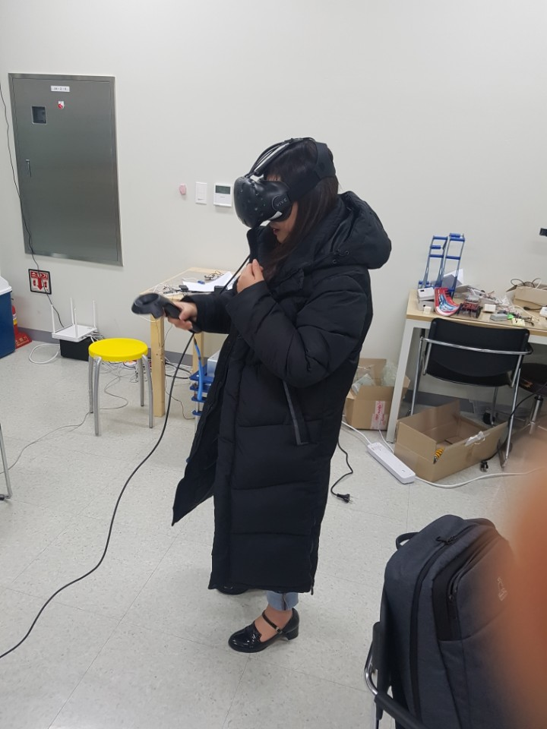
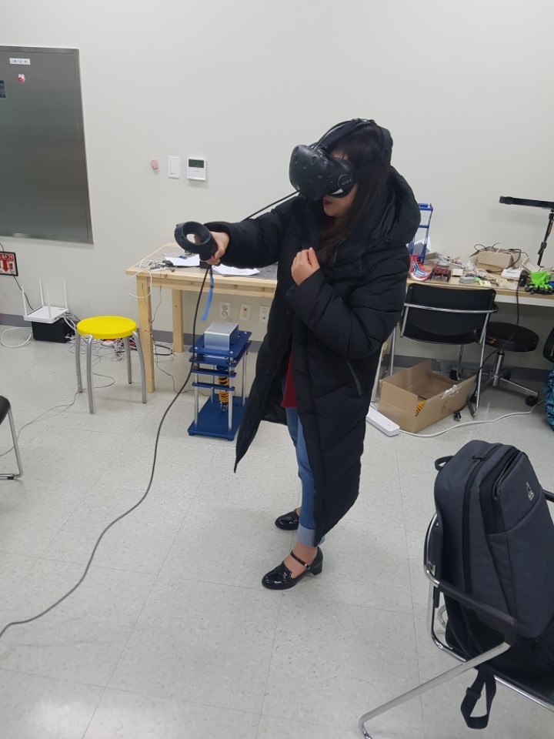
요약
Data 생성 장소 및 일시
산학협력관 # 204호 Intelligent Robotics Lab.
2018/12/5

Slide 3
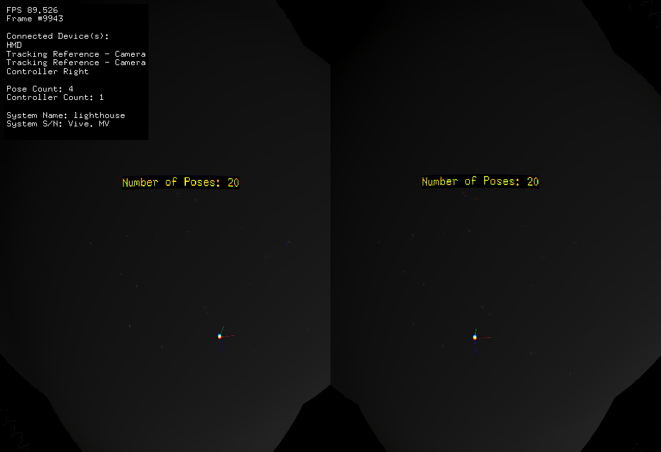
Data #1
컨셉 : 별모양(☆)을 공간에 그리고자 하였다

Slide 4
Data #1 – Validation : 각 축들이 서로 수직임을 확인
x축 |  |  |  | y축 |  |  |  | z축 |  |  |  | translation
x | y | z |  | x | y | z |  | x | y | z |  | x | y | z |  |  | 곱(x축과 y축) | 곱(y축과 z축) | 곱(z축과 x축)
-0.94356 | 0.132079 | 0.303726 | 0 | -0.29623 | 0.07359 | -0.95228 | 0 | -0.14813 | -0.9885 | -0.03031 | 0 | -0.38544 | 1.618581 | 0.222618 | 1 |  | 0 | 0 | 0
-0.79942 | 0.270007 | 0.536681 | 0 | -0.43147 | 0.363569 | -0.82562 | 0 | -0.41804 | -0.89158 | -0.17414 | 0 | -0.25742 | 1.46043 | 0.198288 | 1 |  | 0 | 0 | 0
-0.56957 | 0.304459 | 0.763477 | 0 | -0.395 | 0.713189 | -0.57908 | 0 | -0.72081 | -0.6314 | -0.28595 | 0 | -0.18837 | 1.23523 | 0.080303 | 1 |  | 0 | 0 | 0
-0.33723 | 0.258035 | 0.905369 | 0 | -0.42579 | 0.815913 | -0.39114 | 0 | -0.83963 | -0.5174 | -0.16528 | 0 | -0.30441 | 1.159851 | -0.17723 | 1 |  | 0 | 0 | 0
-0.51991 | 0.173586 | 0.836398 | 0 | -0.32789 | 0.863576 | -0.38305 | 0 | -0.78879 | -0.4734 | -0.39206 | 0 | -0.46136 | 1.126257 | -0.21556 | 1 |  | 0 | 0 | 0
-0.85112 | 0.09023 | 0.517155 | 0 | -0.28284 | 0.751097 | -0.59654 | 0 | -0.44226 | -0.654 | -0.61376 | 0 | -0.60488 | 1.210287 | -0.11633 | 1 |  | 0 | 0 | 0
-0.98228 | 0.002985 | 0.187374 | 0 | -0.14249 | 0.63754 | -0.75713 | 0 | -0.12172 | -0.77041 | -0.62582 | 0 | -0.75129 | 1.28764 | -0.05701 | 1 |  | 0 | 0 | 0
-0.9828 | -0.1021 | -0.15387 | 0 | 0.09739 | 0.421352 | -0.90165 | 0 | 0.156889 | -0.90113 | -0.40416 | 0 | -0.9101 | 1.407909 | -0.05756 | 1 |  | 0 | 0 | 0
-0.97195 | 0.188747 | 0.140334 | 0 | -0.06006 | 0.37769 | -0.92398 | 0 | -0.2274 | -0.90649 | -0.35576 | 0 | -0.72684 | 1.461068 | -0.08421 | 1 |  | 0 | 0 | 0
-0.89323 | 0.346007 | 0.287088 | 0 | -0.11703 | 0.437591 | -0.89153 | 0 | -0.4341 | -0.82994 | -0.35038 | 0 | -0.52935 | 1.456745 | -0.08514 | 1 |  | 0 | 0 | 0
-0.73659 | 0.586163 | 0.337411 | 0 | -0.02973 | 0.470335 | -0.88199 | 0 | -0.67569 | -0.6597 | -0.32902 | 0 | -0.23431 | 1.452507 | -0.0484 | 1 |  | 0 | 0 | 0
-0.63408 | 0.613557 | 0.470627 | 0 | -0.14436 | 0.503993 | -0.85156 | 0 | -0.75967 | -0.6079 | -0.231 | 0 | -0.08075 | 1.430529 | -0.12863 | 1 |  | 0 | 0 | 0
-0.51777 | 0.577023 | 0.631635 | 0 | -0.2806 | 0.58292 | -0.76254 | 0 | -0.8082 | -0.57206 | -0.1399 | 0 | -0.30594 | 1.340037 | -0.20869 | 1 |  | 0 | 0 | 0
-0.69395 | 0.393705 | 0.602848 | 0 | -0.26858 | 0.635291 | -0.72406 | 0 | -0.66805 | -0.66438 | -0.33512 | 0 | -0.61877 | 1.265174 | -0.22415 | 1 |  | 0 | 0 | 0
-0.83243 | 0.335309 | 0.441167 | 0 | -0.01061 | 0.786357 | -0.61768 | 0 | -0.55403 | -0.51886 | -0.65103 | 0 | -0.77174 | 1.148646 | -0.23344 | 1 |  | 0 | 0 | 0
-0.94394 | 0.264146 | 0.198004 | 0 | 0.121686 | 0.83597 | -0.53511 | 0 | -0.30687 | -0.48102 | -0.82125 | 0 | -0.89345 | 1.128509 | -0.3068 | 1 |  | 0 | 0 | 0
-0.92942 | 0.262746 | 0.259109 | 0 | 0.012024 | 0.723352 | -0.69038 | 0 | -0.36882 | -0.63854 | -0.67546 | 0 | -0.92928 | 1.226131 | -0.30832 | 1 |  | 0 | 0 | 0
-0.88588 | 0.312238 | 0.343123 | 0 | -0.12351 | 0.554192 | -0.82318 | 0 | -0.44718 | -0.77161 | -0.45238 | 0 | -0.79956 | 1.392496 | -0.27528 | 1 |  | 0 | 0 | 0
-0.92541 | 0.320538 | 0.202171 | 0 | 0.003706 | 0.541104 | -0.84095 | 0 | -0.37895 | -0.77747 | -0.50193 | 0 | -0.58097 | 1.543696 | -0.13853 | 1 |  | 0 | 0 | 0
-0.91124 | 0.409619 | 0.043102 | 0 | 0.252161 | 0.637557 | -0.72797 | 0 | -0.32567 | -0.65248 | -0.68426 | 0 | -0.43709 | 1.606624 | 0.085727 | 1 |  | 0 | 0 | 0

Slide 5
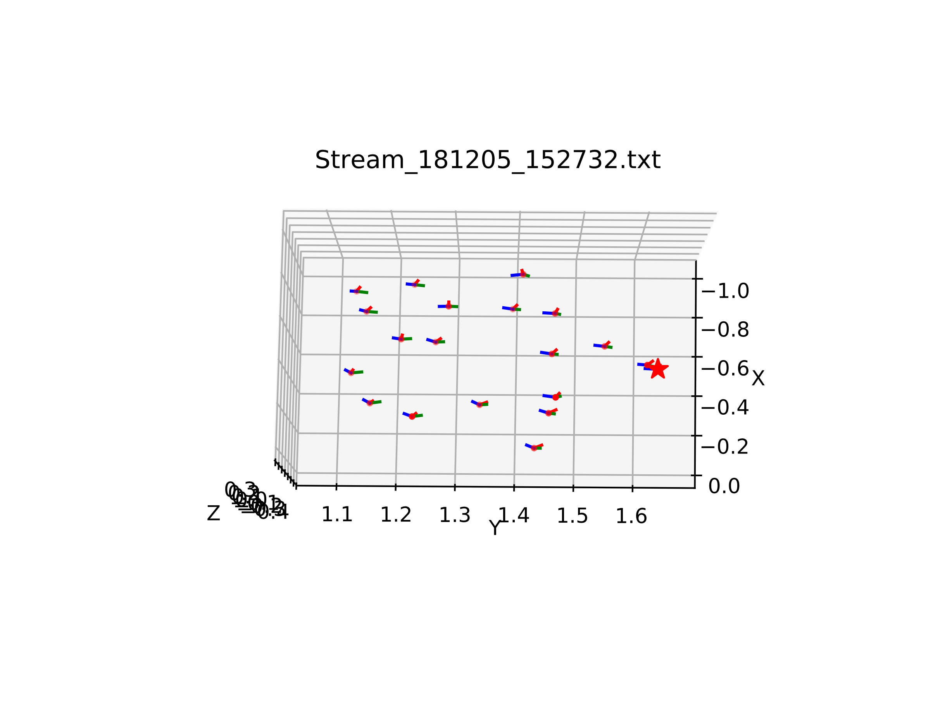
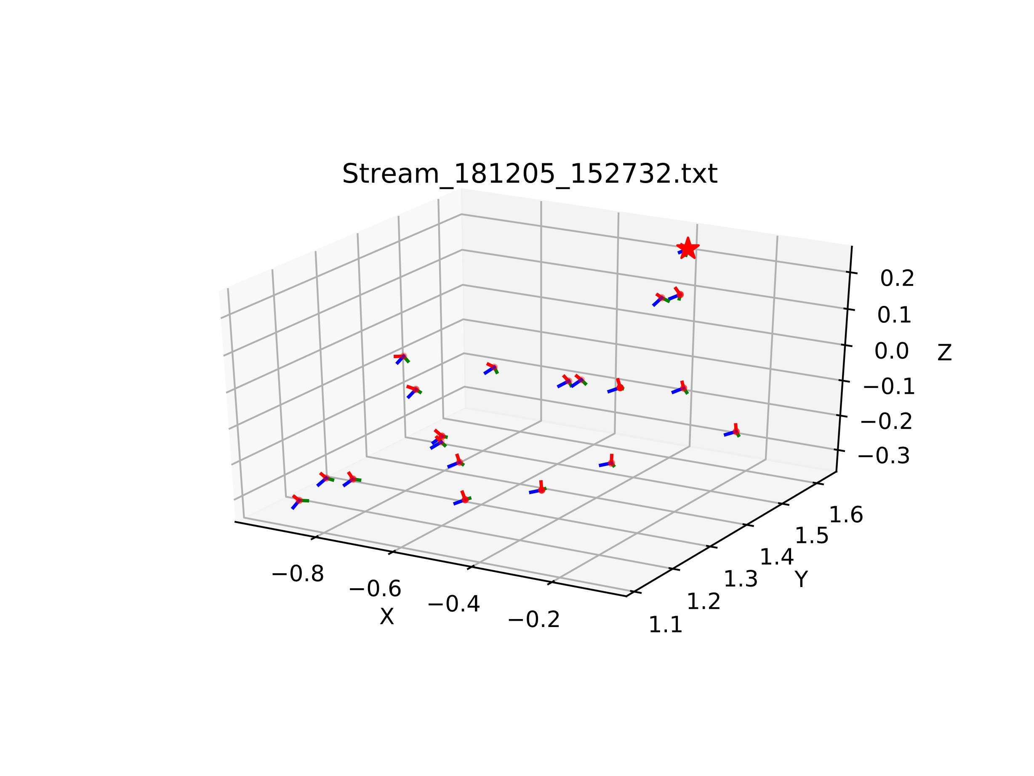
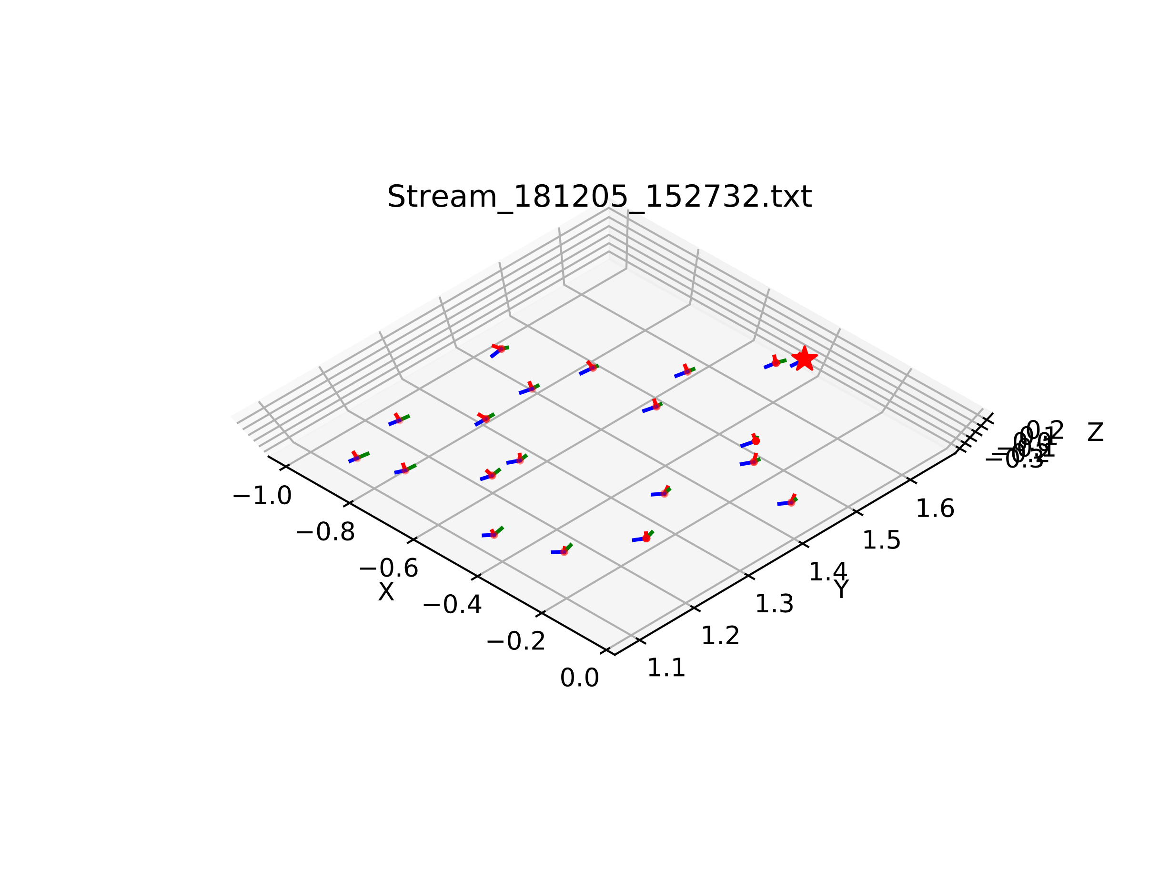
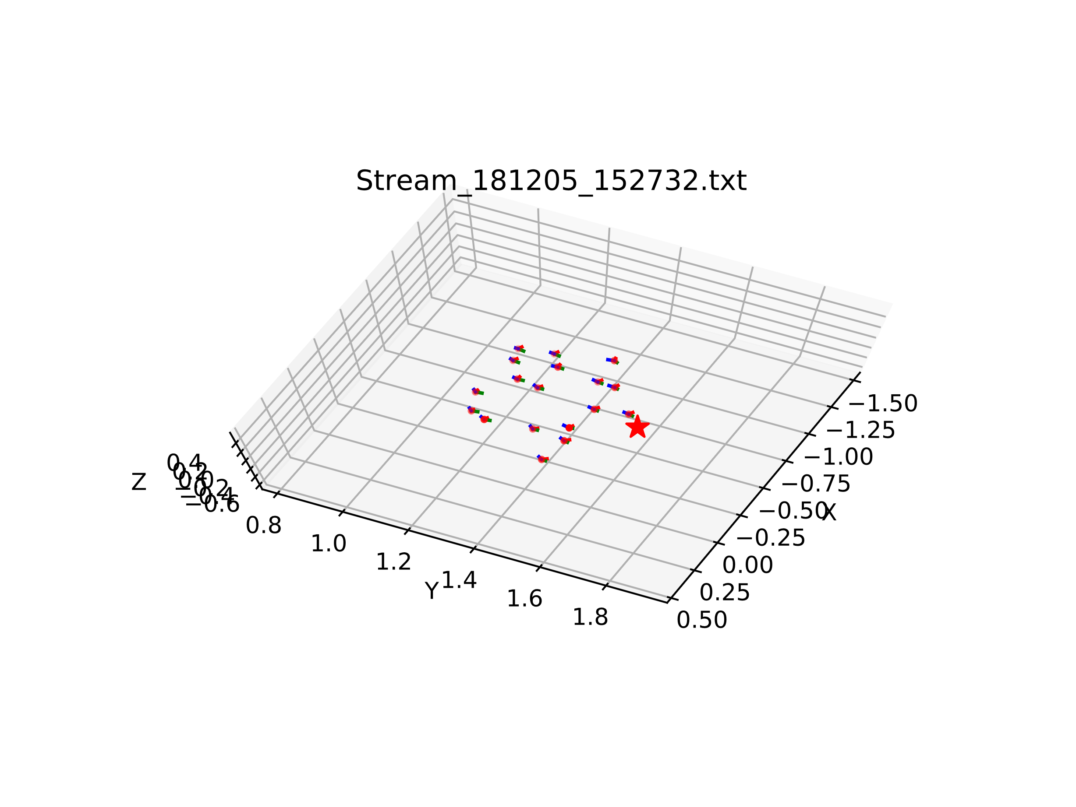
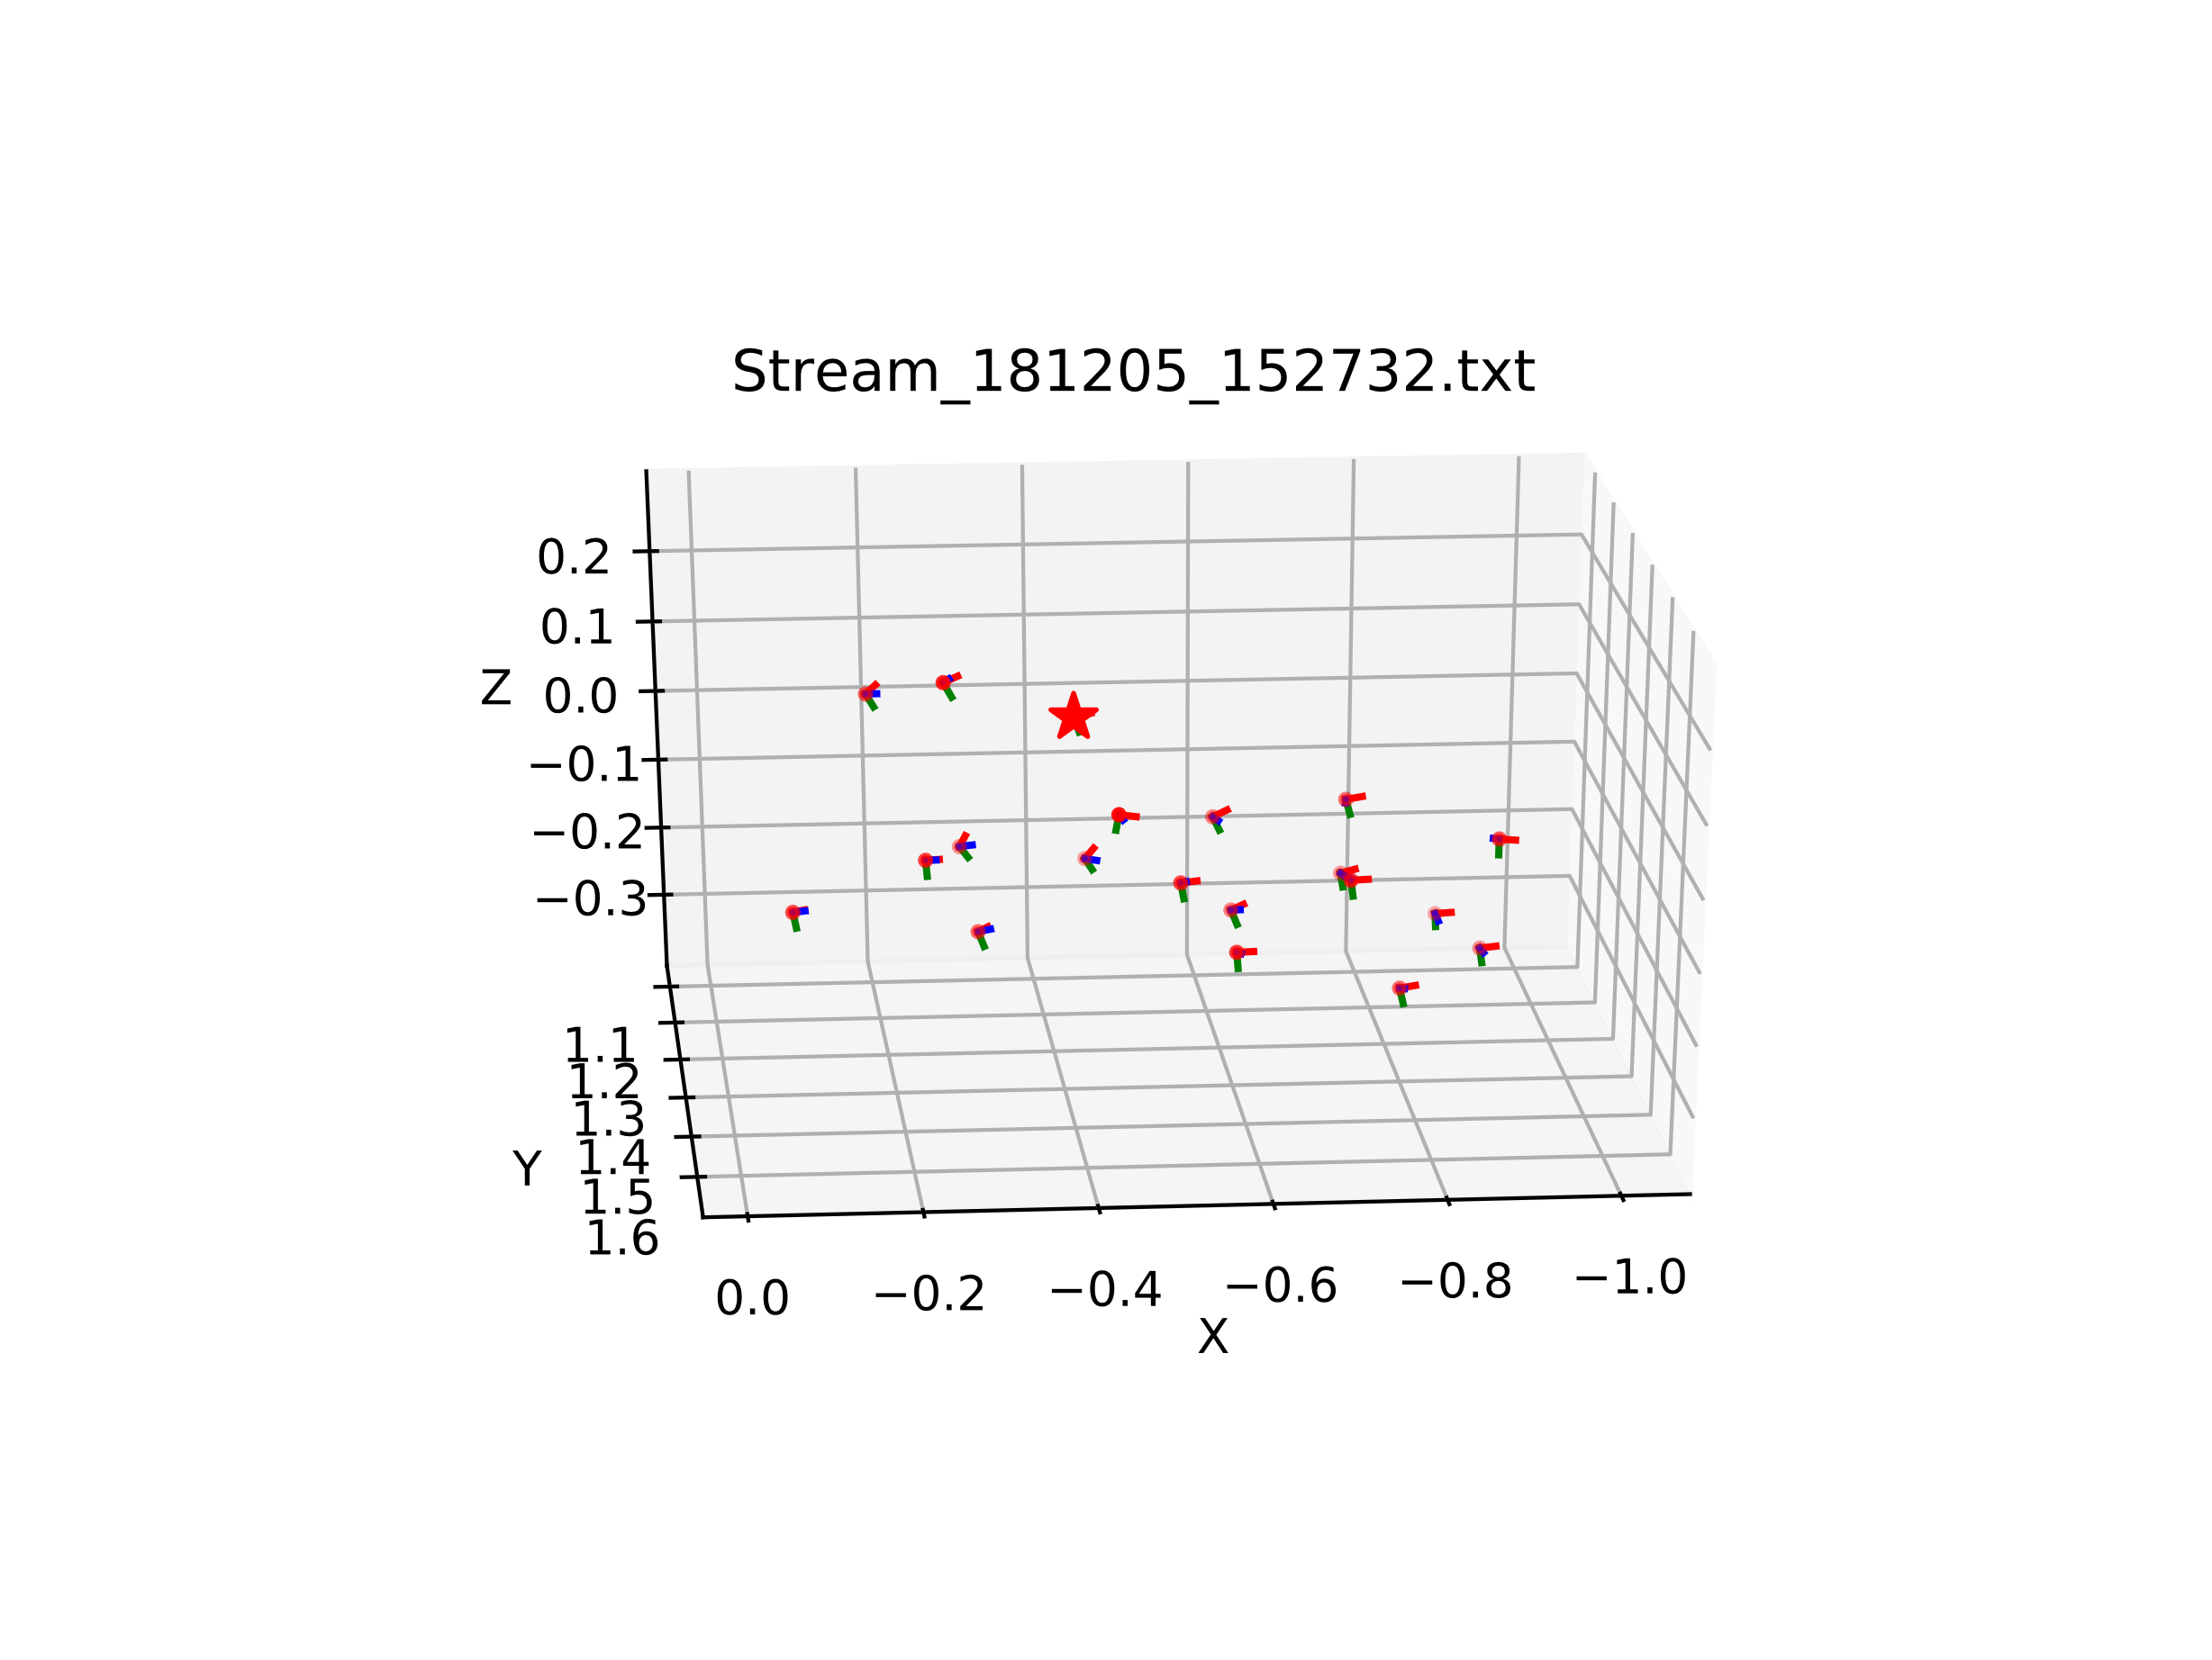
Data #1 – Visualization

Slide 6
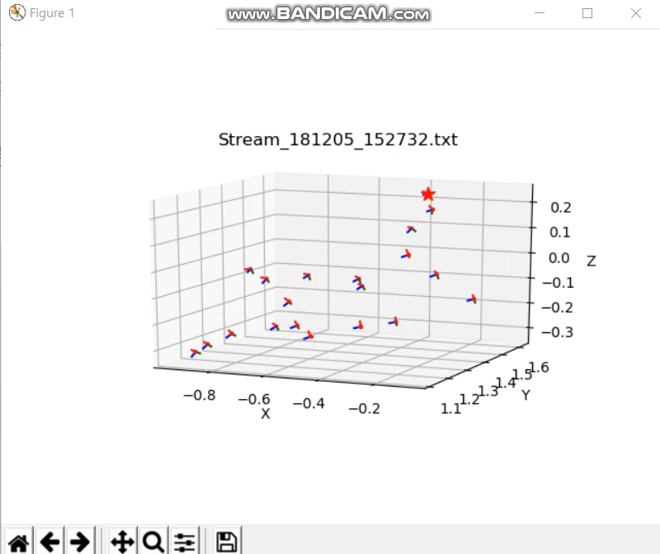
Data #1 – Visualization

Slide 7
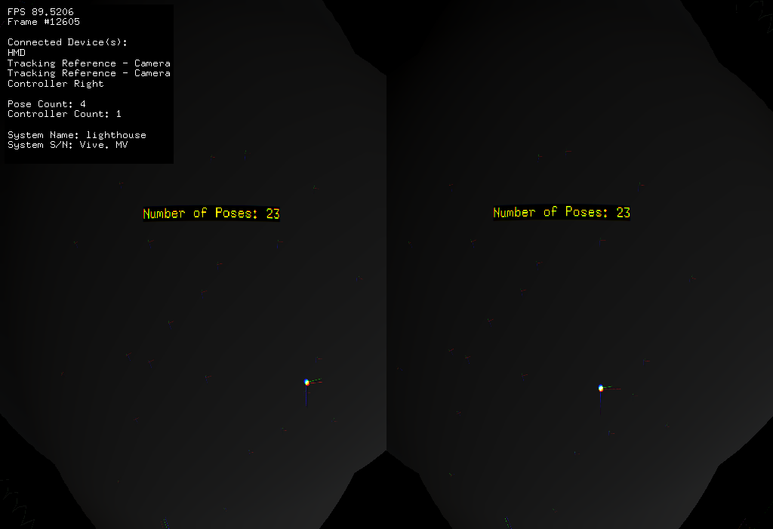
Data #2
컨셉 : 사람 얼굴(☺)을 공간에 그리고자 하였다

Slide 8
Data #2 – Validation : 각 축들이 서로 수직임을 확인
x축 |  |  |  | y축 |  |  |  | z축 |  |  |  | translation
x | y | z |  | x | y | z |  | x | y | z |  | x | y | z |  |  | 곱(x축과 y축) | 곱(y축과 z축) | 곱(z축과 x축)
-0.8876 | -0.10654 | 0.448124 | 0 | -0.45751 | 0.0912 | -0.88451 | 0 | 0.053367 | -0.99012 | -0.12969 | 0 | -0.37044 | 1.711423 | -0.25717 | 1 |  | 0 | 0 | 0
-0.70035 | 0.296764 | 0.649182 | 0 | -0.6156 | 0.209243 | -0.75977 | 0 | -0.36131 | -0.93175 | 0.036144 | 0 | -0.14496 | 1.63115 | -0.37933 | 1 |  | 0 | 0 | 0
-0.51888 | 0.475334 | 0.710512 | 0 | -0.5915 | 0.400432 | -0.69985 | 0 | -0.61717 | -0.7834 | 0.073384 | 0 | -0.01728 | 1.491028 | -0.42874 | 1 |  | 0 | 0 | 0
-0.07676 | 0.621669 | 0.77951 | 0 | -0.3705 | 0.708052 | -0.60116 | 0 | -0.92566 | -0.33495 | 0.17598 | 0 | -0.00657 | 1.174242 | -0.49062 | 1 |  | 0 | 0 | 0
0.026279 | 0.483329 | 0.875044 | 0 | 0.152514 | 0.863161 | -0.48135 | 0 | -0.98795 | 0.146106 | -0.05103 | 0 | -0.15127 | 0.864303 | -0.45592 | 1 |  | 0 | 0 | 0
-0.62777 | 0.332844 | 0.703649 | 0 | 0.289269 | 0.938986 | -0.18609 | 0 | -0.72266 | 0.086722 | -0.68575 | 0 | -0.48808 | 0.824937 | -0.35824 | 1 |  | 0 | 0 | 0
-0.98525 | -0.03745 | -0.16697 | 0 | 0.041564 | 0.894174 | -0.44579 | 0 | 0.165997 | -0.44615 | -0.87943 | 0 | -0.78411 | 1.065385 | -0.17187 | 1 |  | 0 | 0 | 0
-0.97607 | -0.21224 | -0.0474 | 0 | -0.0699 | 0.512622 | -0.85576 | 0 | 0.205925 | -0.83197 | -0.51519 | 0 | -0.80572 | 1.441734 | -0.16853 | 1 |  | 0 | 0 | 0
-0.97881 | -0.09343 | 0.182198 | 0 | -0.19946 | 0.233932 | -0.95157 | 0 | 0.046283 | -0.96775 | -0.24761 | 0 | -0.65309 | 1.619198 | -0.28054 | 1 |  | 0 | 0 | 0
-0.92056 | 0.081919 | 0.38192 | 0 | -0.36087 | 0.195853 | -0.91182 | 0 | -0.1495 | -0.97721 | -0.15073 | 0 | -0.49335 | 1.662623 | -0.36687 | 1 |  | 0 | 0 | 0
-0.78215 | 0.367564 | 0.503121 | 0 | -0.40605 | 0.311778 | -0.85902 | 0 | -0.47261 | -0.87618 | -0.09461 | 0 | -0.2906 | 1.490644 | -0.42517 | 1 |  | 0 | 0 | 0
-0.96962 | 0.046513 | 0.24015 | 0 | -0.21797 | 0.281322 | -0.93453 | 0 | -0.11103 | -0.95849 | -0.26264 | 0 | -0.56267 | 1.504757 | -0.31027 | 1 |  | 0 | 0 | 0
-0.87854 | 0.206524 | 0.430706 | 0 | -0.36171 | 0.301286 | -0.88227 | 0 | -0.31198 | -0.9309 | -0.18999 | 0 | -0.43736 | 1.456586 | -0.37668 | 1 |  | 0 | 0 | 0
-0.83225 | 0.250924 | 0.494361 | 0 | -0.38979 | 0.369266 | -0.84363 | 0 | -0.39424 | -0.89481 | -0.20952 | 0 | -0.40815 | 1.406538 | -0.39115 | 1 |  | 0 | 0 | 0
-0.73269 | 0.330573 | 0.59489 | 0 | -0.43081 | 0.451403 | -0.78143 | 0 | -0.52686 | -0.82883 | -0.18832 | 0 | -0.35237 | 1.351574 | -0.43352 | 1 |  | 0 | 0 | 0
-0.59478 | 0.425915 | 0.681786 | 0 | -0.46031 | 0.514865 | -0.72321 | 0 | -0.65905 | -0.74398 | -0.11018 | 0 | -0.27906 | 1.292138 | -0.48619 | 1 |  | 0 | 0 | 0
-0.63923 | 0.301737 | 0.707344 | 0 | -0.52961 | 0.494186 | -0.68942 | 0 | -0.55758 | -0.81531 | -0.1561 | 0 | -0.35265 | 1.301878 | -0.51 | 1 |  | 0 | 0 | 0
-0.77218 | 0.19303 | 0.605373 | 0 | -0.41525 | 0.567837 | -0.71073 | 0 | -0.48095 | -0.80019 | -0.35832 | 0 | -0.44394 | 1.274375 | -0.44843 | 1 |  | 0 | 0 | 0
-0.57037 | 0.283825 | 0.770795 | 0 | -0.50595 | 0.617851 | -0.60189 | 0 | -0.64707 | -0.73328 | -0.2088 | 0 | -0.30255 | 1.177066 | -0.50172 | 1 |  | 0 | 0 | 0
-0.90012 | 0.084727 | 0.427326 | 0 | -0.18662 | 0.811349 | -0.55397 | 0 | -0.39365 | -0.57839 | -0.7145 | 0 | -0.52905 | 1.051473 | -0.32329 | 1 |  | 0 | 0 | 0
-0.96697 | 0.053074 | 0.249319 | 0 | -0.12269 | 0.760426 | -0.63773 | 0 | -0.22344 | -0.64725 | -0.7288 | 0 | -0.60901 | 1.094187 | -0.27251 | 1 |  | 0 | 0 | 0
-0.9831 | 0.022173 | 0.181699 | 0 | -0.12802 | 0.626212 | -0.76907 | 0 | -0.13084 | -0.77934 | -0.61279 | 0 | -0.65839 | 1.18769 | -0.25255 | 1 |  | 0 | 0 | 0
-0.98765 | 0.026089 | 0.154507 | 0 | -0.12065 | 0.502592 | -0.85606 | 0 | -0.09999 | -0.86413 | -0.49324 | 0 | -0.67925 | 1.269287 | -0.25235 | 1 |  | 0 | 0 | 0

Slide 9
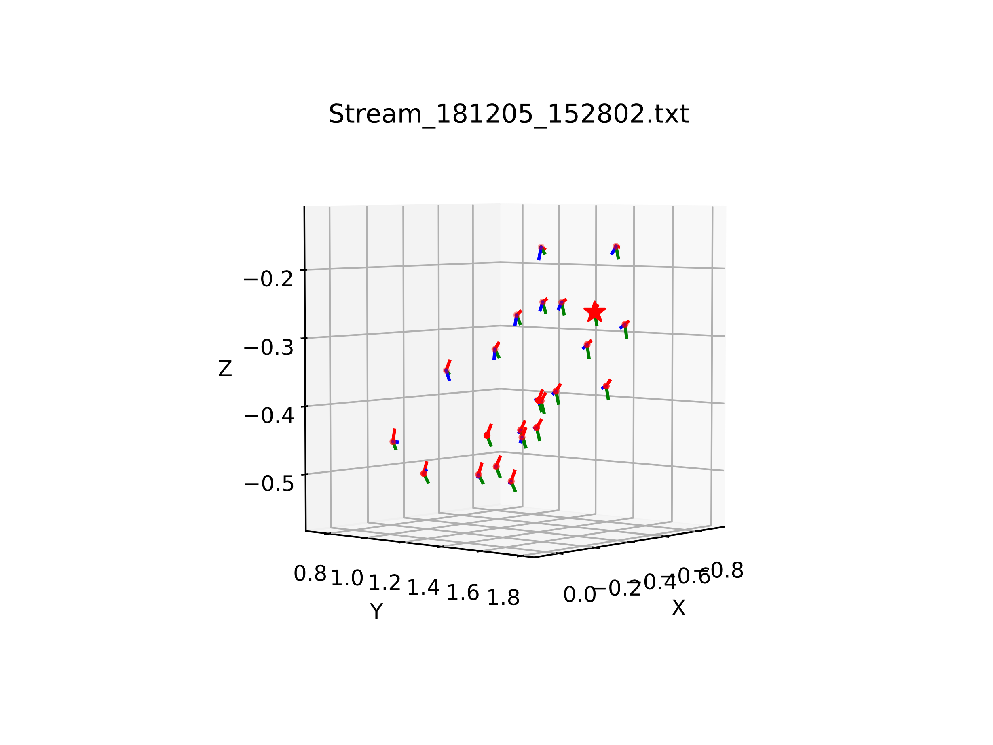
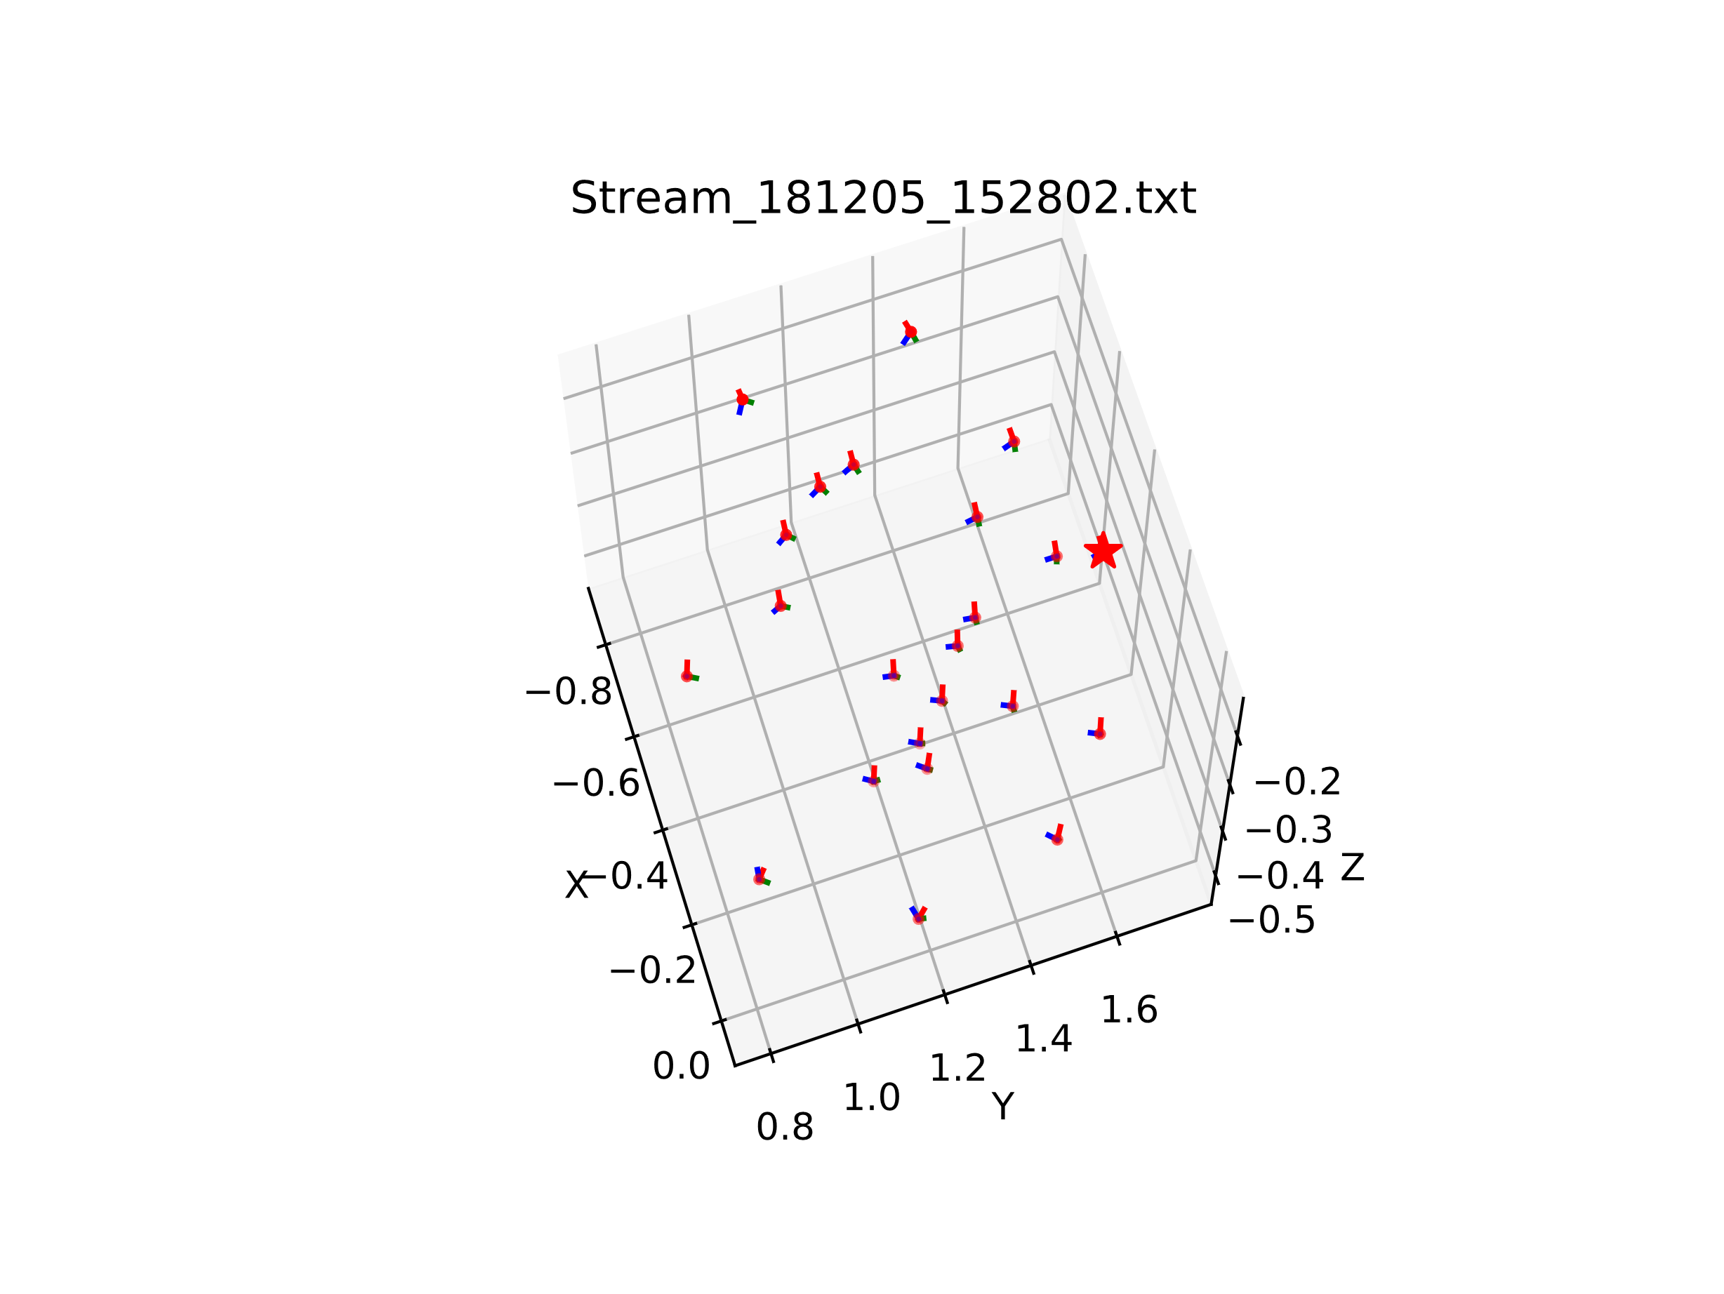
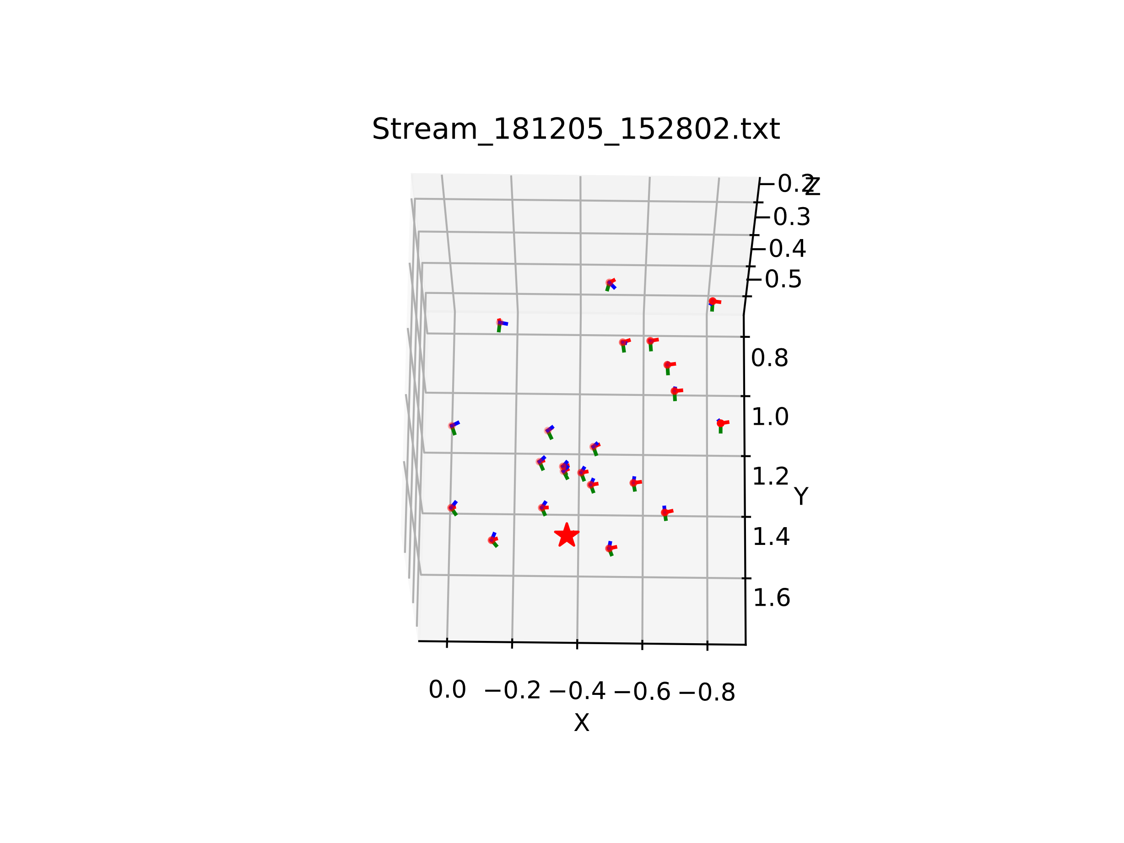
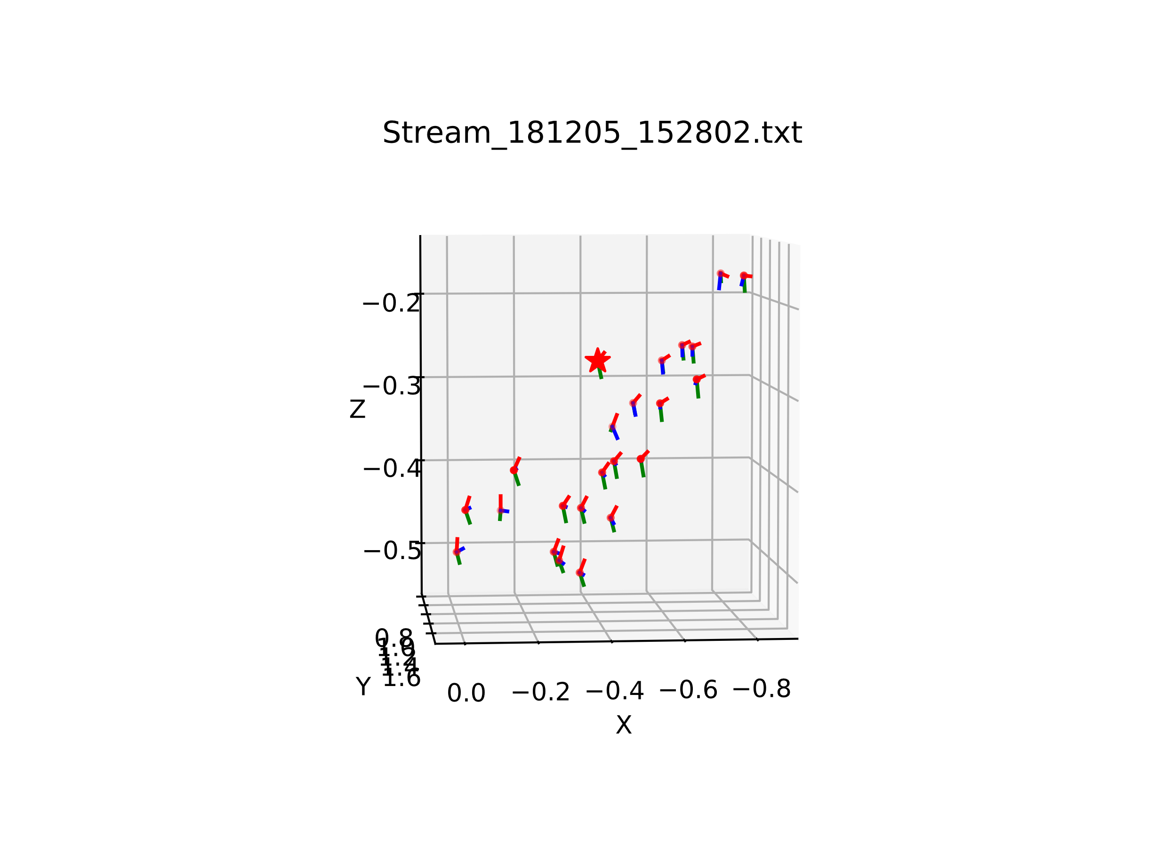
Data #2 – Visualization

Slide 10
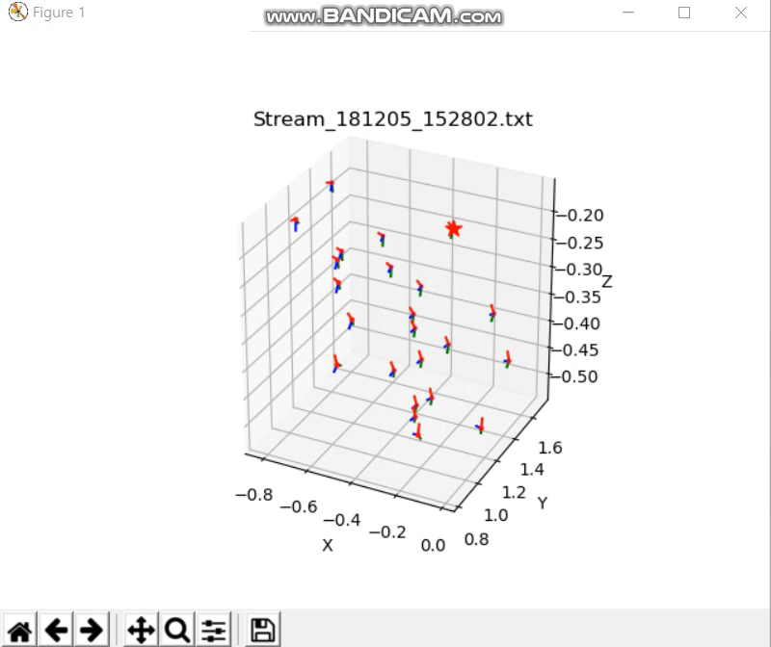
Data #2 – Visualization

